Slide 1
Webinar 1
Naïve Bayes Classifier
Presented by : B Radhika
Email: radhika.richy@wilp.bits-pilani.ac.in

Slide 2
Outline
Introduction
Machine Learning general approach and best practices
Python Libraries
Naïve Bayes Classification
Demo

Slide 3
General Instructions
Check your connectivity and system settings before pinging.
After every concept you can post your questions on the chat box.

Slide 4
Machine Learning project overview
A Machine learning pipeline typically consists of:
Importing Data: csv, xls, JSON ….
Exploratory Data Analysis: Univariate and Multivariate
Data Pre-processing: Missing value imputation, Outlier treatment ….
Model Building: Regression, Classification and Association Analysis
Model Evaluations: Accuracy, Precision, Recall …

Slide 5
Python Libraries
Pandas: Data Manipulations
NumPy: Mathematical operations
Scikit-learn: Scikit-learn is one of the most popular ML libraries for classical ML algorithms
Matplotlib and Seaborn: Visualizations

Slide 6
Naïve Bayes classification
Probabilistic classification
Assumes predictors to be independent of each other, presence of a particular feature in a class is unrelated to the presence of any other feature
Numerical variables are assumed to be normally distributed.

Slide 7
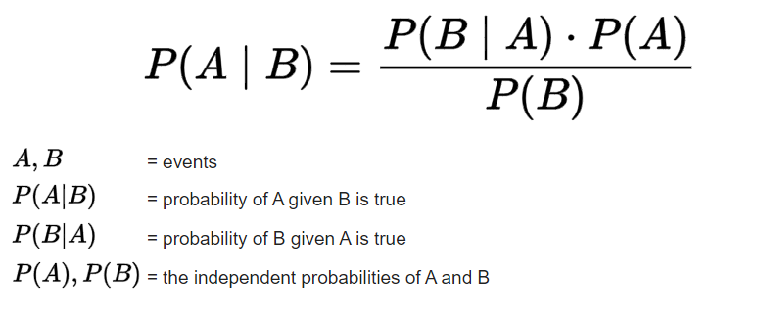
Naïve Bayes classification
Conditional Probability: P(C/A)=P(A,C)/P(A)
Bayes Theorem:

Slide 8
Example Problem Statement
Students list
Name Gender
Kiran M
Asha F
Kiran F
Kiran F
John M
Lata F
Mira F
Salman M
Kiran ? (newbie)
P(M/Kiran)= P(Kiran/M) * P(M)/P(Kiran)
= (1/3 * 3/8)/(3/8)= 1/3
P(F/Kiran)= P(Kiran/F) * P(F)/P(Kiran)
= (2/5 * 5/8)/(3/8)= 2/3
Newbie Kiran is predicted to be a Female!

Slide 9
Demo

Slide 10
Queries??

